Slide 1

FINAL PROJECT
Niharika Dobanaboina

Slide 2

Objective
To analyze the monthly fuel contract information, purchases, and costs related to the US energy data.

Slide 3
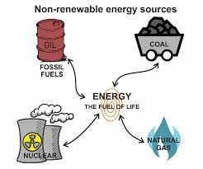
DATA DESCRIPTION Variables used to analyze the Data:
Fuel received units
Contract type code
Fuel MMBtu per unit
Energy source code
Sulfur content pct
Fuel group code
Mercury content ppm
Primary transportation mode code
Fuel cost per mmbtu
Fuel type code PUDL
Ash content pct

Slide 4
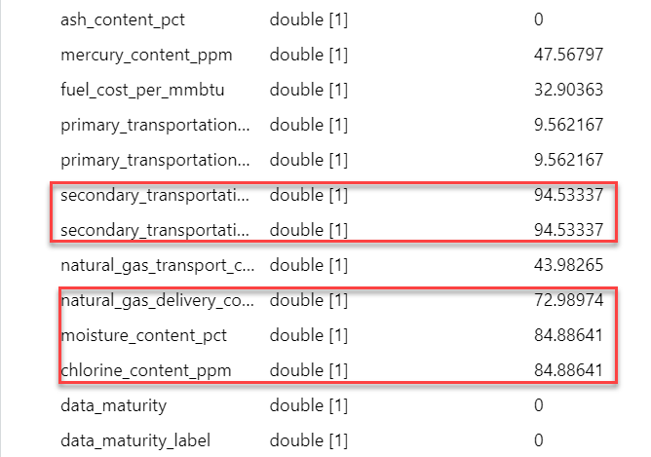
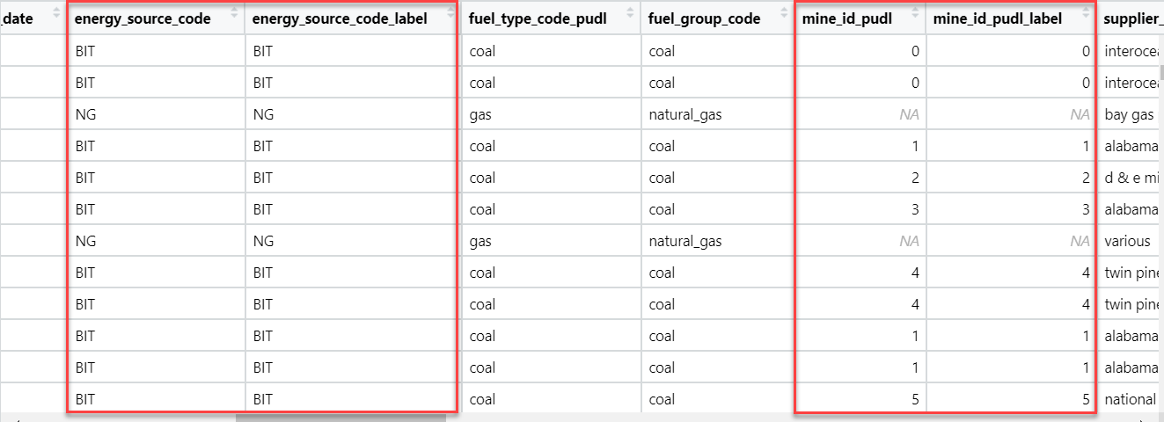
DATA DESCRIPTION Reasons for not considering certain Variables:
1. Missing values: Excluded variables having more than 50% missing values.
2. Redundant data: Ignored variables which has same data as another variable.

Slide 5


According to the U.S. Energy Information Administration, most of the nation’s electricity was generated by natural gas, nuclear energy, and coal in 2020. Source: Link

Slide 6
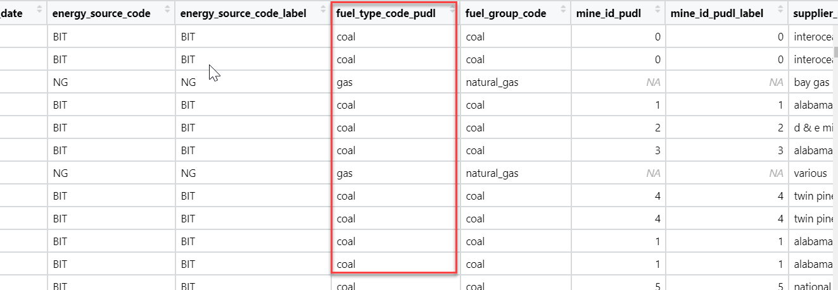
DATA DESCRIPTION The key variable used for data analysis:
Fuel type code PUDL
Coal
Gas
Oil

Slide 7
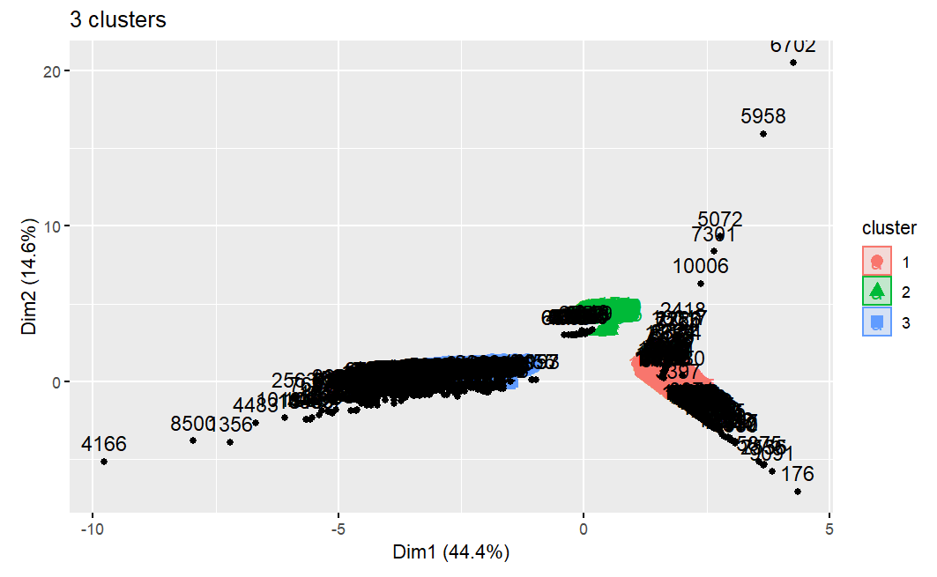
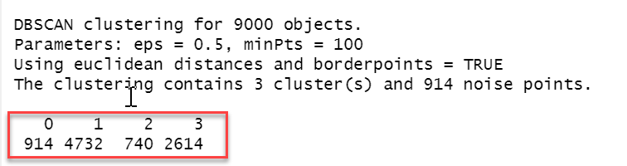
The algorithm used to form Clusters:
DBSCAN algorithm is used to form clusters in order to draw meaningful insights about U.S. energy.
DBSCAN is known to be the best algorithm that handles outliers and noisy data.
Why DBSCAN?

Slide 8
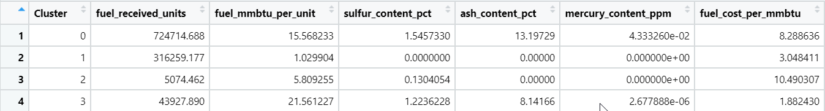
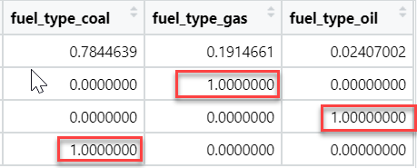
Findings from Clusters:
Names of each cluster:
Cluster 1: Gas
Cluster 2: Oil
Cluster 3: Coal

Slide 9
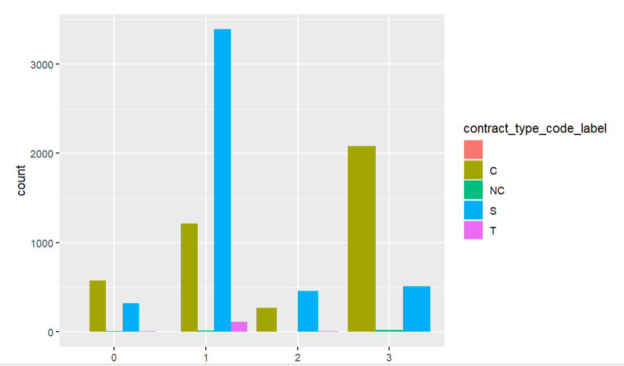
Analysis of Clusters 1: Gas
Fuel Received Units | Fuel mmbtu per Unit | Sulfur Content pct | Ash Content pct | Mercury Content ppm | Fuel cost per mmbtu
316259.17 | 1.0299 | 0.00 | 0.00 | 0.00 | 3.0484
Low Fuel cost per MMBtu
The highest Number of units received
No chemical components
Heat generated is less
Contract type is Contract based.

Slide 10
Analysis of Clusters 2: Oil
Fuel Received Units | Fuel MMBtu per Unit | Sulfur Content pct | Ash Content pct | Mercury Content ppm | Fuel cost per mmbtu
5074.462 | 5.8093 | 0.1340 | 0.00 | 0.00 | 10.4903
Highest Fuel cost per MMBtu
Least number of units received
Small percent of Sulfur Content
The heat generated is 5.8 MMBtu
Contract type is Spot

Slide 11
Analysis of Clusters 3: Coal
Fuel Received Units | Fuel MMBtu per Unit | Sulfur Content pct | Ash Content pct | Mercury Content ppm | Fuel cost per mmbtu
43927.890 | 21.5612 | 1.2236 | 8.1416 | 2.678e-06 | 1.8824
Lowest Fuel cost per MMBtu
High fuel units received
Contains Fuel, ash, sulfur content
Heat generated is High
Contract type is Contract and Spot

Slide 12
Comparing 3 types of fuels:

Slide 13
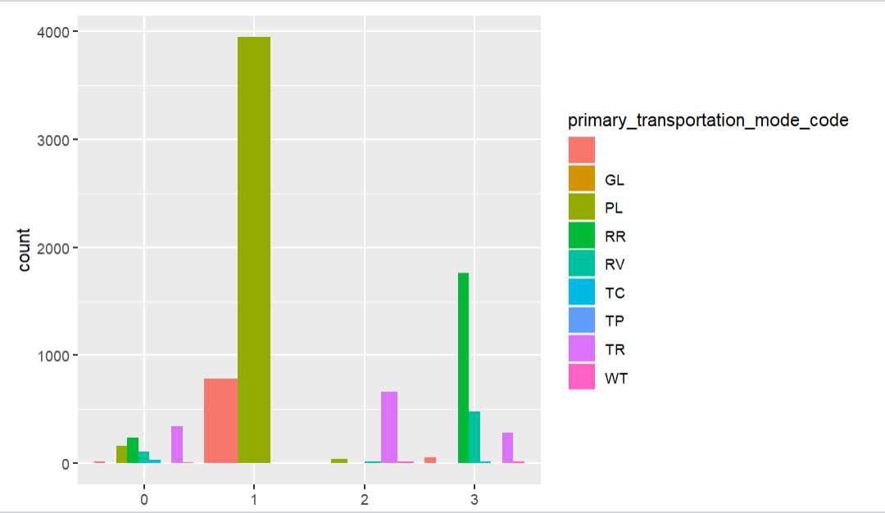
Comparing 3 types of fuels:

Slide 14
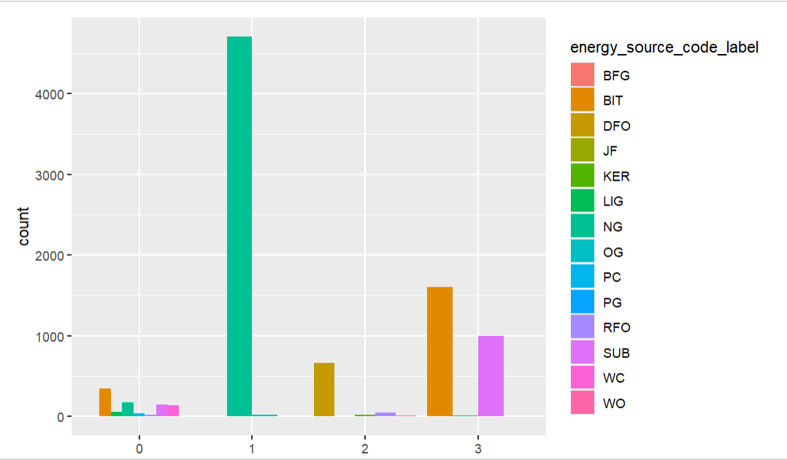
Energy source codes of fuels:
Gas
Natural Gas
Oil
Distillate Fuel Oil
Coal
Conventional Steam coal

Slide 15

Conclusion

Slide 16
Thank you!!

